Slide 1
Military Techincal Academy
Principles of Programming Language
Syntax

Slide 2
Introduction
Languages have a “grammar”, i.e., rules
Programming languages have a grammar as well
Designers design them
Users learn and use them
This lecture: How to describe them

Slide 3
Introduction
Syntax: the form or structure of the expressions, statements, and program units
Semantics: the meaning of the expressions, statements, and program units
Syntax and semantics provide a language’s definition
  Users of a language definition
    Other language designers
    Implementers
    Programmers (the users of the language

Slide 4
The General Problem of Describing Syntax: Terminology
A sentence is a string of characters over some alphabet
A language is a set of sentences
A lexeme is the lowest level syntactic unit of a language (e.g., *, sum, begin)
A token is a category of lexemes (e.g., identifier)

Slide 5
Formal Definition of Languages
Recognizers
  A recognition device reads input strings over the alphabet of the language and decides whether the input strings belong to the language
  Example: syntax analysis part of a compiler

Slide 6
Formal Definition of Languages
Generators
  A device that generates sentences of a language
  One can determine if the syntax of a particular sentence is syntactically correct by comparing it to the structure of the generator

Slide 7
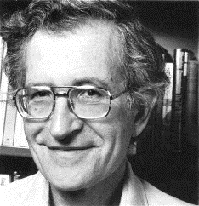
BNF and Context-Free Grammars
Context-Free Grammars
  Developed by Noam Chomsky in the mid-1950s
  Language generators, meant to describe the syntax of natural languages
  Define a class of languages called context-free languages

Slide 8
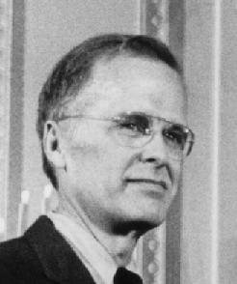
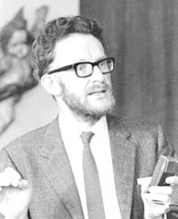
BNF and Context-Free Grammars
Backus-Naur Form (1959)
  Invented by John Backus to describe Algol 58
  Modified by Peter Naur
  BNF is equivalent to context-free grammars

Slide 9
BNF Fundamentals
A metalanguage is a language that is used to describe another language
BNF is a metalanguage for programming language

Slide 10
BNF Fundamentals
In BNF, abstractions are used to represent classes of syntactic structures
Abstraction is called nonterminals
Terminals are lexemes or tokens
A rule has a left-hand side (LHS), which is a nonterminal, and a right-hand side (RHS), which is a string of terminals and/or nonterminals
Nonterminals are often enclosed in angle brackets

Slide 11
BNF Fundamentals
Abstraction/nonterminal
Lexeme/
terminal
Abstraction/nonterminal
<assign> → <var> = <expression>
RHS
Tokens, lexemes,
abstractions
…
LHS
Abstraction being defined
Rule

Slide 12
BNF Fundamentals
Abstraction/nonterminal
Lexeme/
terminal
Abstraction/nonterminal
<assign> → <var> = <expression>
An example sentence whose syntactic structure is described by this rule:
Total = subtotal1 + subtotal2

Slide 13
BNF Fundamentals
Abstraction/nonterminal
Lexeme/
terminal
Abstraction/nonterminal
<assign> → <var> = <expression>
A BNF description, or grammar, is simply a collection of rules

Slide 14
BNF Rules
An abstraction (or nonterminal symbol) can have more than one RHS
<stmt> → <single_stmt> | begin <stmt_list> end
Alternative RHS

Slide 15
Describing Lists
Syntactic lists are described using recursion
  <ident_list> → ident | ident, <ident_list>

Slide 16
Grammar and Derivation
A grammar is a generative device for defining a language
Sentences are generated through a sequence application s of the rules, beginning with a special nonterminal of the grammar call the start symbol
A sentence generation is called a derivation.
A derivation is a repeated application of rules, starting with the start symbol and ending with a sentence (all terminal symbols)

Slide 17
Derivations
Every string of symbols in a derivation is a sentential form
A sentence is a sentential form that has only terminal symbols
A leftmost derivation is one in which the leftmost nonterminal in each sentential form is the one that is expanded
A derivation may be neither leftmost nor rightmost

Slide 18
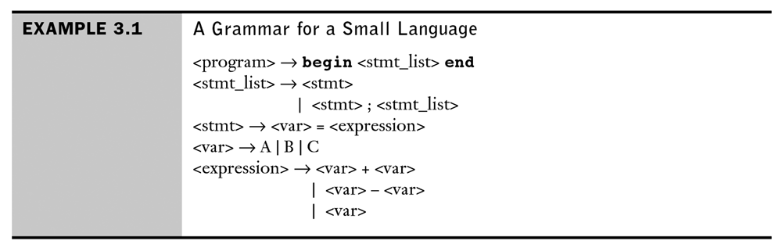
An Example: Grammar

Slide 19
An Example: A Derivation
<program> => begin <stmt_list> end
=> begin <stmt>; <stmt_list> end
=> begin <var> = <expression>; <stmt_list> end
=> begin A=<expression>; <stmt_list> end
=> begin A = <var> + <var>; <stmt_list> end
=> begin A = B + <var>; <stmt_list> end
=> begin A = B + C; <stmt_list> end
=> begin A = B + C; <stmt> end
=> begin A = B + C; <var> = <expression> end
=> begin A = B + C; B = <expression> end
=> begin A = B + C; B = <var> end
=> begin A = B + C; B = C end

Slide 20
An Example: A Derivation
<program> => begin <stmt_list> end
=> begin <stmt>; <stmt_list> end
=> begin <var> = <expression>; <stmt_list> end
=> begin A=<expression>; <stmt_list> end
=> begin A = <var> + <var>; <stmt_list> end
=> begin A = B + <var>; <stmt_list> end
=> begin A = B + C; <stmt_list> end
=> begin A = B + C; <stmt> end
=> begin A = B + C; <var> = <expression> end
=> begin A = B + C; B = <expression> end
=> begin A = B + C; B = <var> end
=> begin A = B + C; B = C end
The replaced nonterminal is always the leftmost nonterminal in the previous sentential form – leftmost derivation

Slide 21
An Example: A Derivation
<program> => begin <stmt_list> end
=> begin <stmt>; <stmt_list> end
=> begin <var> = <expression>; <stmt_list> end
=> begin A=<expression>; <stmt_list> end
=> begin A = <var> + <var>; <stmt_list> end
=> begin A = B + <var>; <stmt_list> end
=> begin A = B + C; <stmt_list> end
=> begin A = B + C; <stmt> end
=> begin A = B + C; <var> = <expression> end
=> begin A = B + C; B = <expression> end
=> begin A = B + C; B = <var> end
=> begin A = B + C; B = C end
Stop when the sentential form contains no nonterminals

Slide 22
An Example: A Derivation
By choosing alternative RHSs of rules with which to replace nonterminals in the derivation, different sentences in the language can be generated.
By exhaustively choosing all combinations of choices, the entire language can be generated.
This, like most others, is infinite. It is impossible to generate all the sentences in the language in finite time

Slide 23
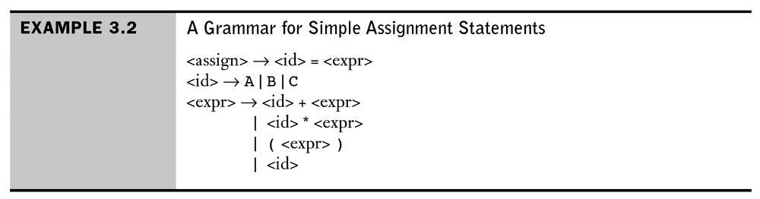
An Example: Grammar
This grammar describes assignment statements whose right sides are arithmetic expressions with multiplication and addition operators and parentheses.

Slide 24
An Example: A Derivation
The statement
  A = B*(A+C)
is generated by leftmost derivation:
<assign> =><id>=<expr>
=>A=<expr>
=>A=<id>*<expr>
=>A=B*<expr>
=>A=B*(<expr>)
=>A=B*(<id>+<expr>)
=>A=B*(A+<expr>)
=>A=B*(A+<id>)
=>A=B*(A+C)

Slide 25
Parsing
Latin – Quae pars orationis?
English – Which part of speech?
Parsing is the process of breaking down sentences
  In natural languages
  In programming languages
  In command and control languages

Slide 26
Parse Tree
A parse tree shows how a string of terminals can be generated from the rules of the grammar
Root is labeled with the (nonterminal) start symbol
Each leaf is labeled with a terminal (or a string of terminals)
The label of a non-leaf node is a non-terminal

Slide 27
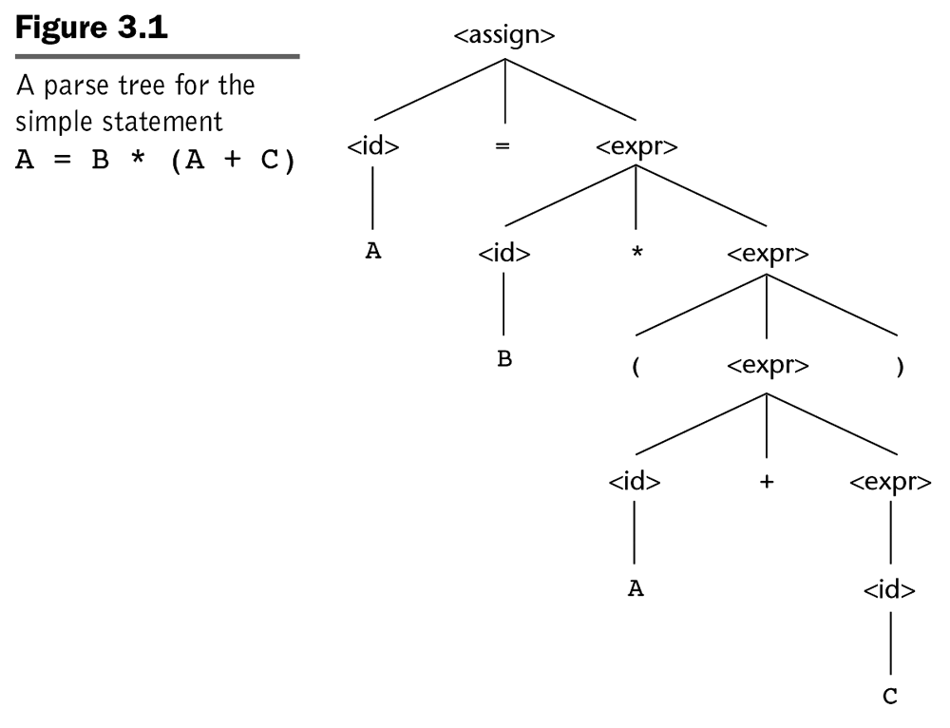
Parse Tree

Slide 28
Parse Tree
Every internal node is labeled with a nonterminal symbol

Slide 29
Parse Tree
Every leaf is labeled with a terminal symbol

Slide 30
Parse Tree
Every sub-tree describes one instance of an abstraction in the sentence

Slide 31
Ambiguity in Grammars
Example grammar
<expr> → <expr> + <expr> | <expr> * <expr> | (<expr> ) | <number>
<number> → <number> <digit> | <digit>
<digit> → 0 | 1 | 2 | 3 | 4 | 5 | 6 | 7 | 8 | 9
Given 234 we have different derivations
number => <number><digit> number =><number>< digit>
=> <number> 4 => <number>< digit> <digit>
=> <number><digit> 4 => <digit>< digit>< digit>
=> <number> 3 4 => 2 <digi><t digit>
=> <digit> 3 4 => 2 3 <digit>
=> 234 => 234

Slide 32
Ambiguity in Grammars
Example grammar
However the parse tree is the same in either case
number
number
digit
number
digit
4
3
digit
2

Slide 33
Ambiguity in Grammars
Two different derivations can lead to the same the parse tree, this is good because the grammar is unambiguous
However, it isn’t always the case.

Slide 34
Ambiguity in Grammars
A grammar is ambiguous if and only if it generates a sentential form that has two or more distinct parse trees

Slide 35
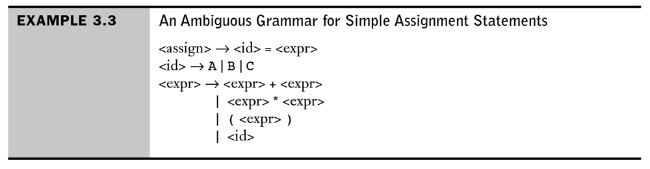
Ambiguity in Grammars

Slide 36
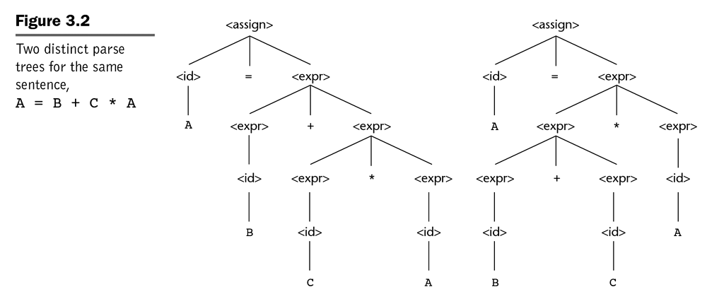
Ambiguity in Grammars

Slide 37
Ambiguity in Grammars

Slide 38
Removing Ambiguity
A grammar that produces different parse trees depending on derivation order is considered ambiguous
We can try to revise the grammar and introduce a disambiguating rule to establish which of the trees we want
In the previous example we want multiplication to take precedence over addition, thus we tend to write a special grammar rule that establishes a precedence cascade to force the * at the lower point in the tree

Slide 39
Operator Precedence
x + y*z
One semantic issue is the order of evaluation
This can be resolved by assigning different precedence levels
* is assigned a higher precedence than + (by the designer)
Multiplication will always be done first, regardless of the order of appearance of the two operators

Slide 40
Operator Precedence
An operator is generated lower in the parsing tree indicates it has precedence over an operator higher up in the tree
In the grammar, introduce more nonterminals and new rules
  <expr> (defines +, -)
  <term> (defines *, /)
  <factor> (defines numbers, unary -)

Slide 41
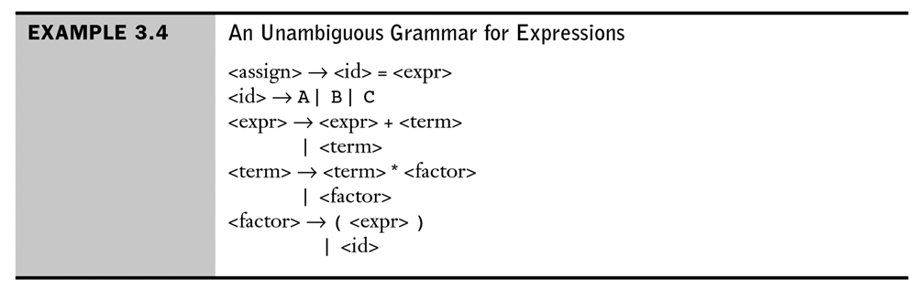
Operator Precedence
Force + to the top of the passing tree
* will be lower in the parsing tree, because it is farther from the start symbol than + in every derivation

Slide 42
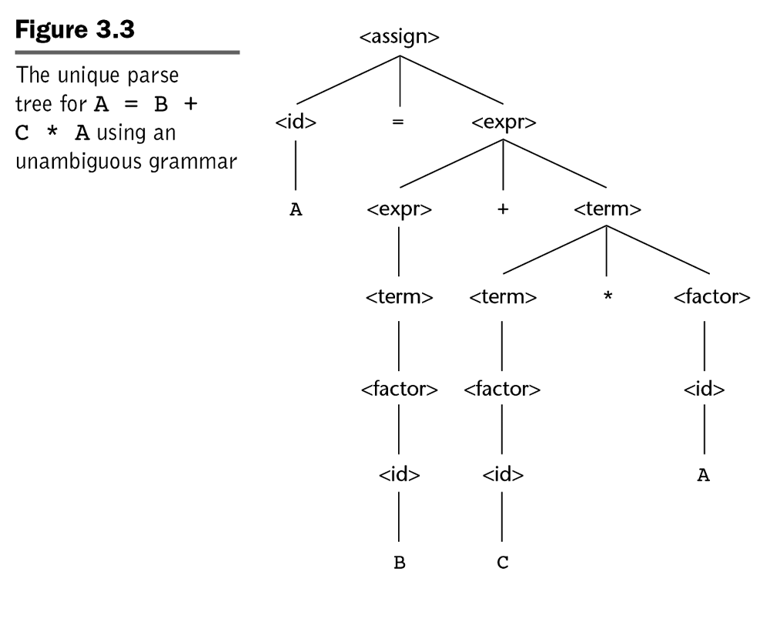
Operator Precedence

Slide 43
Operator Precedence
Leftmost or Rightmost derivation will lead to the same parsing tree

Slide 44
Associativity of Operators
When an expression includes two operators that have the same precedence, A/B*C, a semantic rule is required to specified which should have precedence – this rule is associativity

Slide 45
Associativity of Operators
Left Recursive – LHS appearing in the beginning of its RHS – specifies left associativity
+ and * are left associative

Slide 46
Associativity of Operators
Right Recursive – RHS appearing in the right end of the RHS – specifies right associativity
Exponentiation should is right associative
  <factor> → <exp>**<factor> | <expr>
  <exp> → (<expr>) | id
  Could be used to describe exponentiation as a right associative operator

Slide 47
Extended BNF
Optional parts are placed in brackets [ ]
<proc_call> -> ident [(<expr_list>)]
Alternative parts of RHSs are placed inside parentheses and separated via vertical bars
<term> → <term> (+|-) const
Repetitions (0 or more) are placed inside braces { }
<ident> → letter {letter|digit}

Slide 48
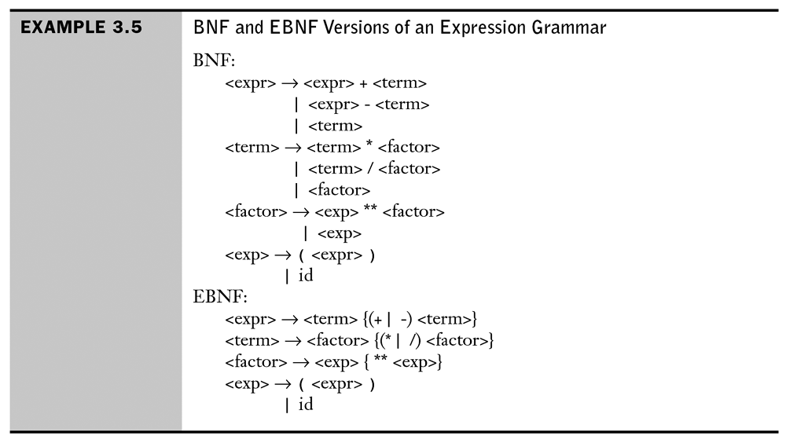
Extended BNF

Slide 49
Semantics Overview
Specifying the semantics of a programming language is a much more difficult task than specifying syntax.
We need formal semantics to define all the props of a language that are not specified with a BNF (declaration before use, some type issues, etc.)
Three approaches
  Reference Manual Approach (in English as precise as we can make things)
  Define a translator- see what the language does by experimentation
    Seems ridiculous but is this how HTML/CSS/JS is often dealt with, the popular browser(s) being the translators?
  Formal definition – very precise, but complex

Slide 50
Semantics Overview
Specifying the semantics of a programming language is a much more difficult task than specifying syntax.
We need formal semantics to define all the props of a language that are not specified with a BNF (declaration before use, some type issues, etc.)
Three approaches
  Reference Manual Approach (in English as precise as we can make things)
  Define a translator- see what the language does by experimentation
    Seems ridiculous but is this how HTML/CSS/JS is often dealt with, the popular browser(s) being the translators?
  Formal definition – very precise, but complex

Slide 51
Semantics Overview
The advantages of the formal definition is that it is so precise that programs can be proven correct and translators validated to produce the defined behavior.
Formal definitions for semantics have not met with complete acceptance, multiple approaches are pushed and many are not well understood and most not used with common languages (at least not initially).

Slide 52
Semantics Overview
Three methods for formal semantics
  Operational Semantics – defines a language by describing its actions in terms of operations on an actual or hypothetical machine
  Denotational semantics – uses mathematical functions on programs to specify semantics
  Axiomatic semantics – applies mathematical logic to language definition. Assertions or predicates are used to describe desired outcomes and initial assumptions. Constructs transform new assertions out of old ones reflecting the action of the construct. These transforms can prove the desired outcome follows from the initial conditions (a correctness proof)

Slide 53
Semantics
There is no single widely acceptable notation or formalism for describing semantics
Operational Semantics
  Describe the meaning of a program by executing its statements on a machine, either simulated or actual. The change in the state of the machine (memory, registers, etc.) defines the meaning of the statement
  To use operational semantics for a high-level language, a virtual machine in needed
  A hardware pure interpreter would be too expensive to create

Slide 54
Semantics
A software pure interpreter also has problems:
A possible alternative: A complete computer simulation
The process:
  Build a translator (translates source code to the machine code of an idealized computer)
  Build a simulator for the idealized computer
Evaluation of operational semantics:
Good if used informally (language manuals, etc.)
Extremely complex if used formally (e.g., VDL –Vienna Definition Language)

Slide 55
Semantics
Axiomatic Semantics
Based on formal logic (first order predicate calculus)
Original purpose: formal program verification
Approach: Define axioms or inference rules for each statement type in the language (to allow transformations of expressions to other expressions)

Slide 56
Semantics
Denotational Semantics
Based on recursive function theory
The most abstract semantics description method
Originally developed by Scott and Strachey (1970)
The process of building a denotational spec for a language (not necessarily easy):
  Define a mathematical object for each language entity
  Define a function that maps instances of the language entities onto instances of the corresponding mathematical objects

Slide 57
Semantics
The difference between denotational and operational semantics:
In operational semantics, the state changes are defined by coded algorithms
In denotational semantics, they are defined by rigorous mathematical functions

Slide 58
Semantics
Evaluation of denotational semantics:
  Can be used to prove the correctness of programs
  Provides a rigorous way to think about programs
  Can be an aid to language design
  Has been used in compiler generation systems
  Probably way beyond what most folks will get involved with

Slide 59
Summary
BNF and context-free grammars are equivalent meta-languages
  Well-suited for describing the syntax of programming languages
Three primary methods of semantics description
  Operation, axiomatic, denotational

